Slide 1
Linked List

Slide 2
Definition
A sequential collection of ordered or unordered list.
Made up of independent nodes that contain any type.
Each node has reference to the next node in the link.
A linear data structure that consists of series of nodes connected by pointers or references.
They are not contiguous in memory.

Slide 3
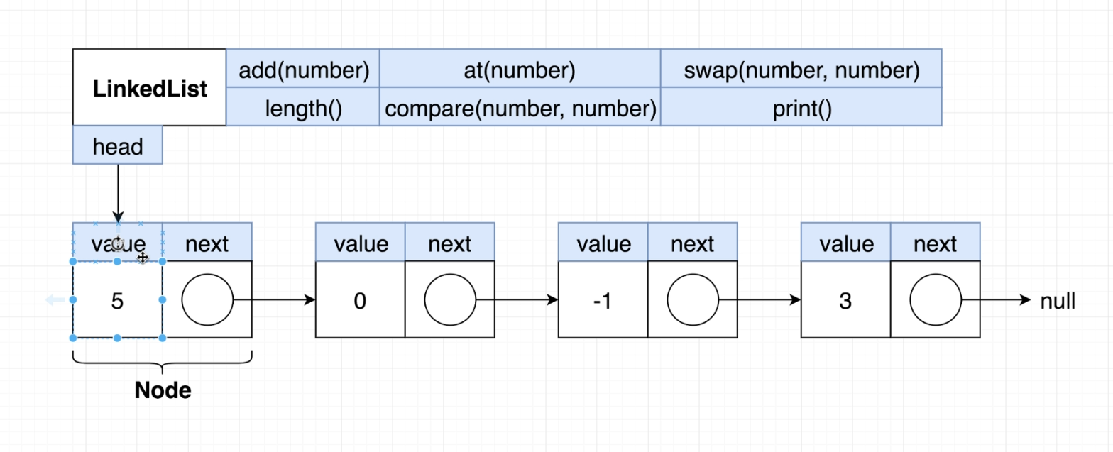
Structure

Slide 4
Types of Linked lists
Singly Linked List
Circular Singly Linked List
Doubly Linked List
Circular Doubly Linked List

Slide 5
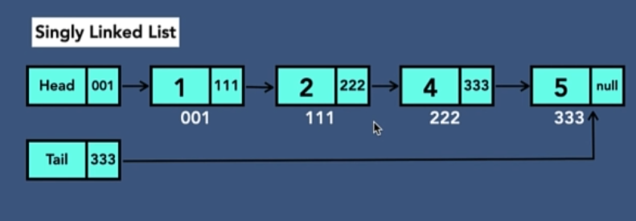
1. Singly linked list
Each Node/Link, stores value and reference to the next node and the last node contains null, specifying the end of the list.

Slide 6
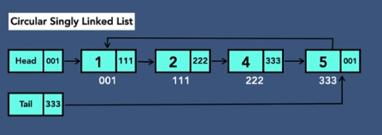
2. Circular Singly Linked List
Unlike Singly, the last node holds reference to the first node, hence circular.

Slide 7
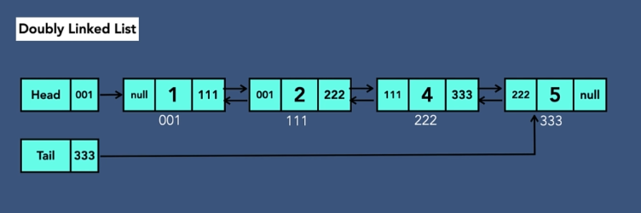
3. Doubly linked list
Each node contains the reference to both next and previous node.
The last node has null for next and first node has null in prev.

Slide 8
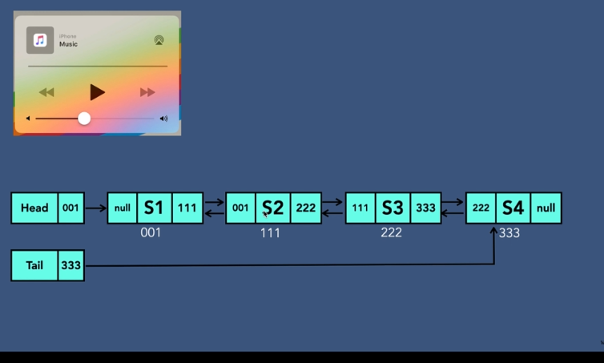
Example

Slide 9
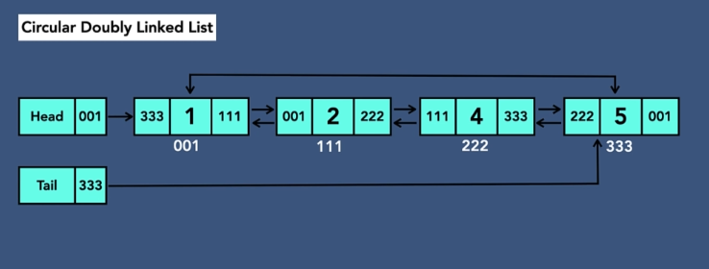
4. Circular Doubly linked List
Last and first node have no null values
For first node, previous points to last node, and for last node, next reference first node.

Slide 10
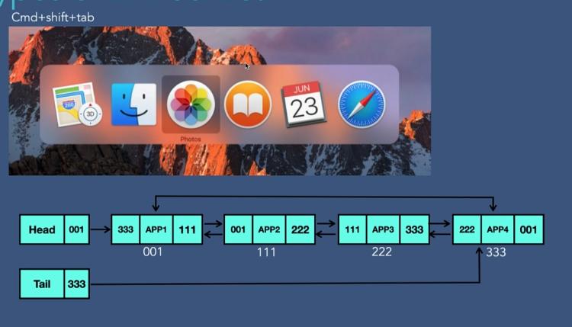
Example

Slide 11
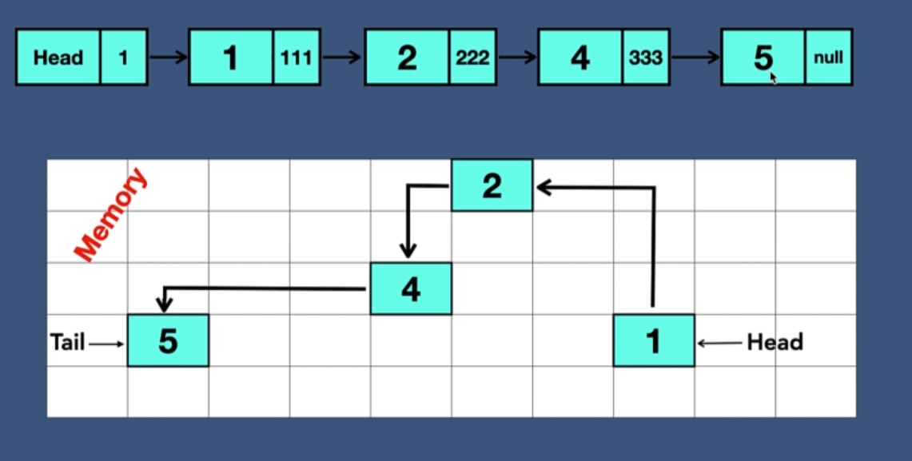
Linked List in memory

Slide 12
Implementation

Slide 13
1. Singly linked list
Create Head with null
Create Tail with null
Create a black node, and assign it a value and reference set to null
Link Head and tail with this nod
Head reference to first node
Tail References last node

Slide 14
Adding element in singly linked list
At the beginning
In the middle
At the end

